Slide 1

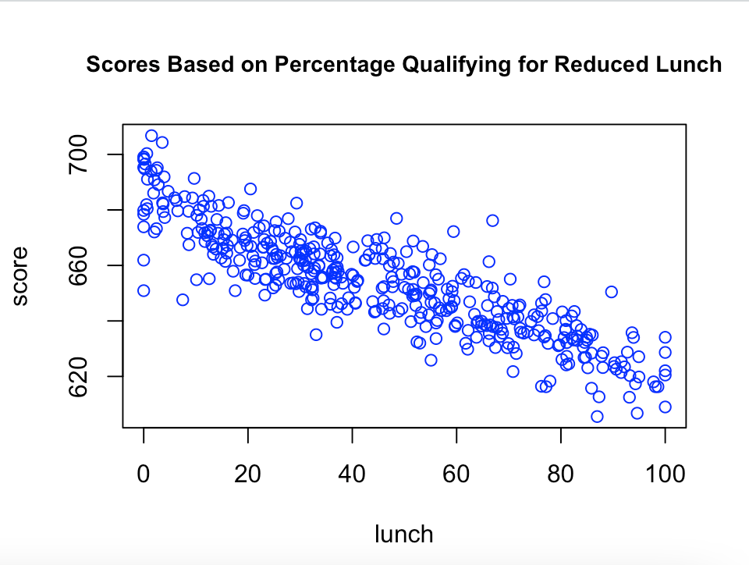
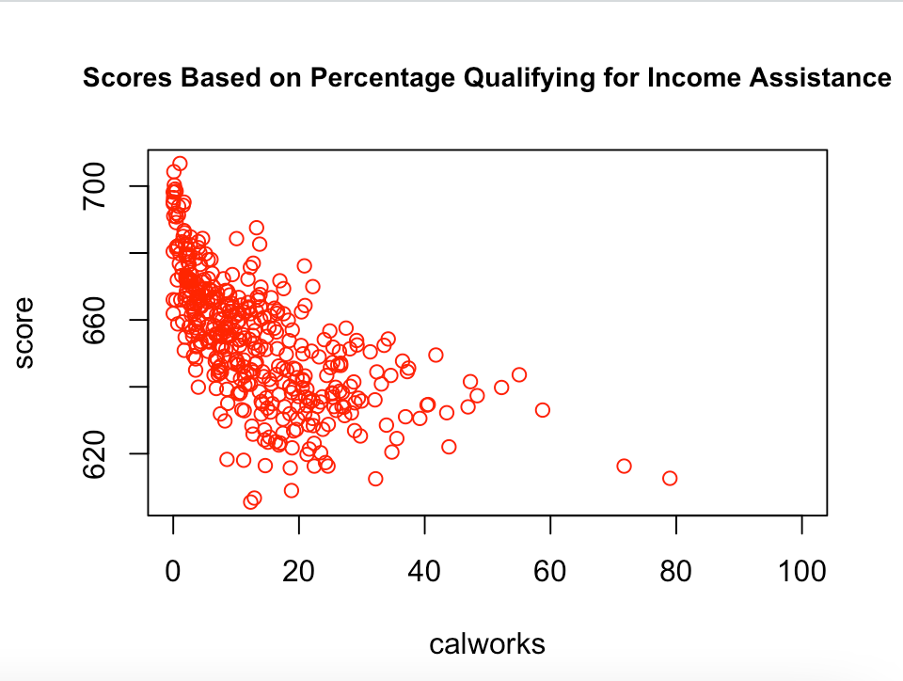
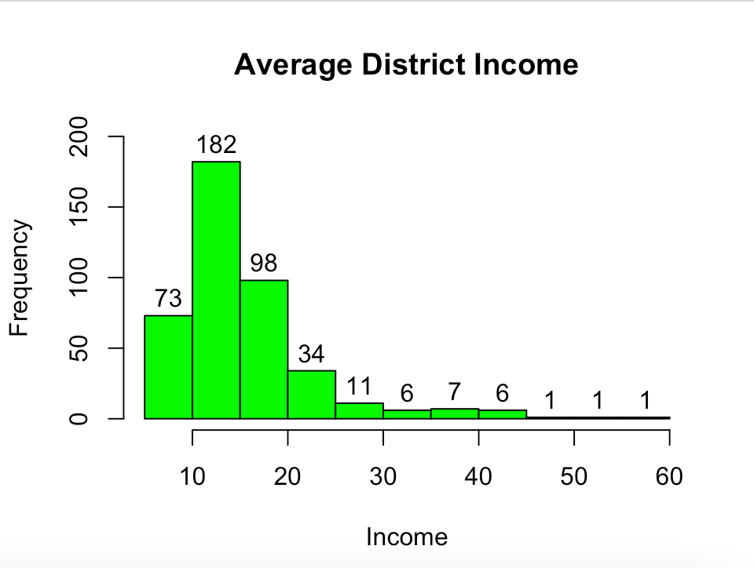
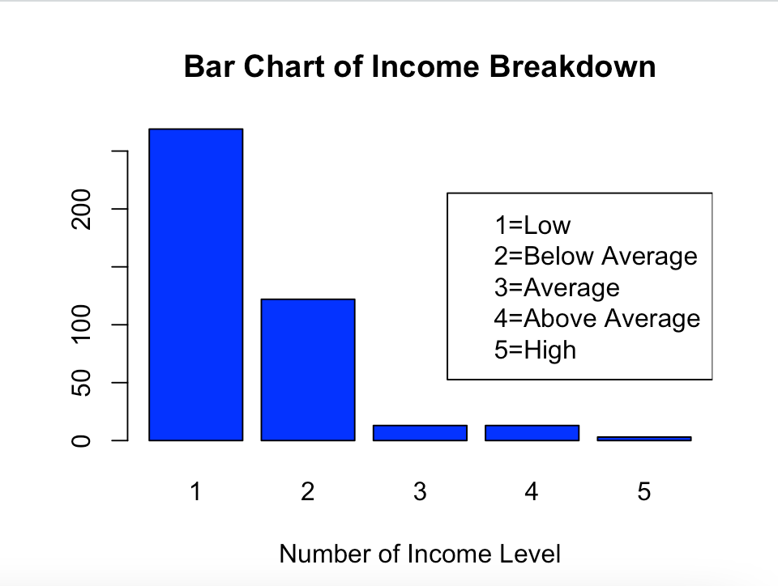
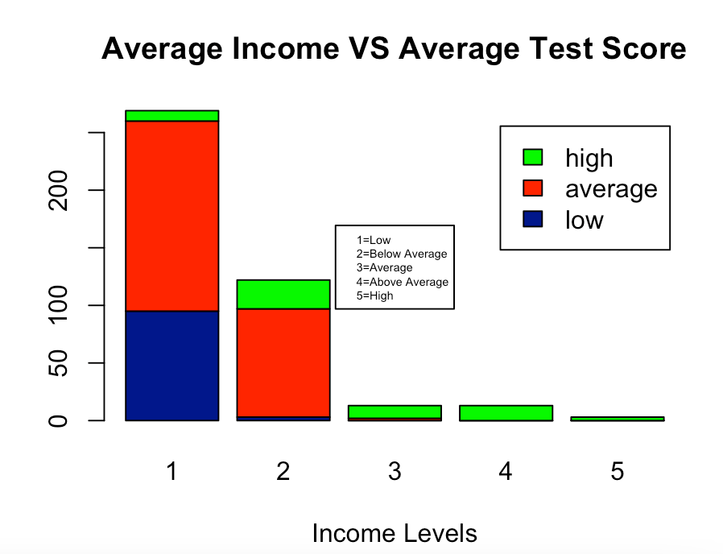
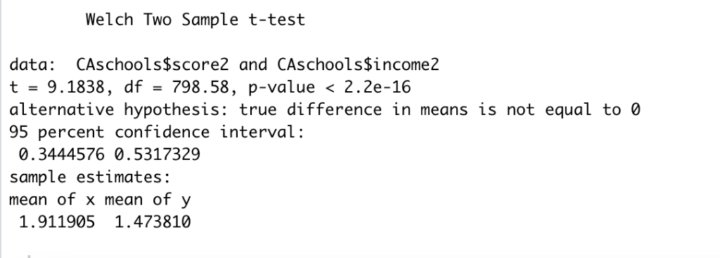
California Test Scores:
Impact of Income on Student Test Scores
Ayara Dixson and Naike Placide
Dr. Gene Ray
STAT 4030: Programming in R
Introduction
Results
Research Question: Does the district and school income have an effect on the student’s average English, Reading and Math test scores?
Hypothesis: Student’s test scores are impacted directly by the school district and income.
Schools are an important part of life in the United States. Tests serve as a way to assess whether or not the students are retaining the information they learned. The income of school districts and teachers can have a great impact on many things such as class sizes, teaching quality and courses offered. Based on previous research on similar topics, it was founded that the students’ achievements were directly associated with the school’s resources. The purpose of this analysis is to determine if the district and average income have an effect on the student’s average English, reading and math test scores. The results from this analysis will provide schools with a better insight on the correlation between test scores and the effect that socioeconomic backgrounds have on them. This information will allow districts to better allocate their funds and resources. Therefore, if low-income schools receive an equal amount of resources as other schools, the students’ test scores should improve.
When working with the school data set our focus was finding out whether or not income affected the average test schools in the districts from our data set. Looking at Figure 3 we can see that schools that had a higher percentage of students qualifying for reduced lunch had lower test schools. We see that overall trend leads shows us that districts with lower reduced lunch percentages have higher test scores.
We can see a similar trend in Figure 4 which compares the average test scores versus the percentage of students qualifying for income assistance. Looking at the statistical data up until Figure 4 it gives us the trend that income plays a major role in average test schools. Once we created a stacked bar chart of the average income versus the average test score the data was much clearer. In Figure 5 we notice that the most of the lower test scores are housed in the lowest income level.
After analyzing the Figure 5 and the data from our t-test of the average income versus the average test score. We know that the p-value that is less than the significance level alpha=0.05, we can conclude that average income is significantly different from the average test score. A limiting factor to this statistical analysis it the groups sizes that the average income and average test scores were split into. Our Figures paired with the data from the t-test help determine whether test scores are restricted when they have a higher percentage of lower income students that attend the school in that district.
Figure 3
Figure 4
Data
CONCLUSION
The data used for this analysis was collected from all 420 K-6 and K-8 districts in California from 1998 to 1999. Since the data obtained was from a specified group of students during a specific time frame, the data is an experimental, cross-sectional study. The test scores in the data are from the Stanford 9 standardized test, administered to 5th grade students. The school characteristics studied included the number of students enrolled, the number of teachers, the number of computers per classroom, and the expenditures per student. The demographics variable collected in the data is averaged throughout the district. It consists of the percentage of students in the public assistance program (CalWorks), the percentage of students that qualify for reduced lunch, and the number of students whom English is their second language.
After performing statistical analysis on the data set using charts and t test. We decide that based of this data set average income did play are part in the average test scores in each district. We are able to see this results in different way in the graphs and data provided in this paper. Figures 3 and 4 depict the easiest visual of the test score average getting lower as the income and reduced lunch percentages get higher. The results of the research lets us know that we have a problem with results in districts that are predominantly lower income. Researchers have been studying test scores in relation to income levels and are also having similar problems. With the research we conducted we know that we must put more focus on districts that are poverty stricken in order to improve the downward trend on test scores.
Figure 5
Figure 6
REFERENCES
Addison, K. L., & Jackson, C. (2018, July). Understanding the Relationships between Poverty, School Factors and Student Achievement [PDF]. Rockville: Office of Shared Accountability. https://files.eric.ed.gov/fulltext/ED598342.pdf
California Test Score Data. (2007). Retrieved December 06, 2020, from https://vincentarelbundock.github.io/Rdatasets/doc/AER/CASchools.html
Newmann, F., Bryk, A., & Nagaoka, J (2001). Authentic intellectual work and standardized Tests: Conflict consortium on chicago school research. retrieved from https://files.eric.ed.gov/fulltext/ED470299.pdf
Reardon, S. F. (2013, May). The Widening Income Achievement Gap. Retrieved December 07, 2020, from http://www.ascd.org/publications/educational-leadership/may13/vol70/num08/The-Widening-Income-Achievement-Gap.aspx
Figure 7
Figure 8

